Slide 1



Mur ligases crystallization
Lizbe Koekemoer (CMD, Frank von Delf lab, University of Oxford)
Laura Diaz Saez (Chris Dowson lab, University of Warwick)

Slide 2
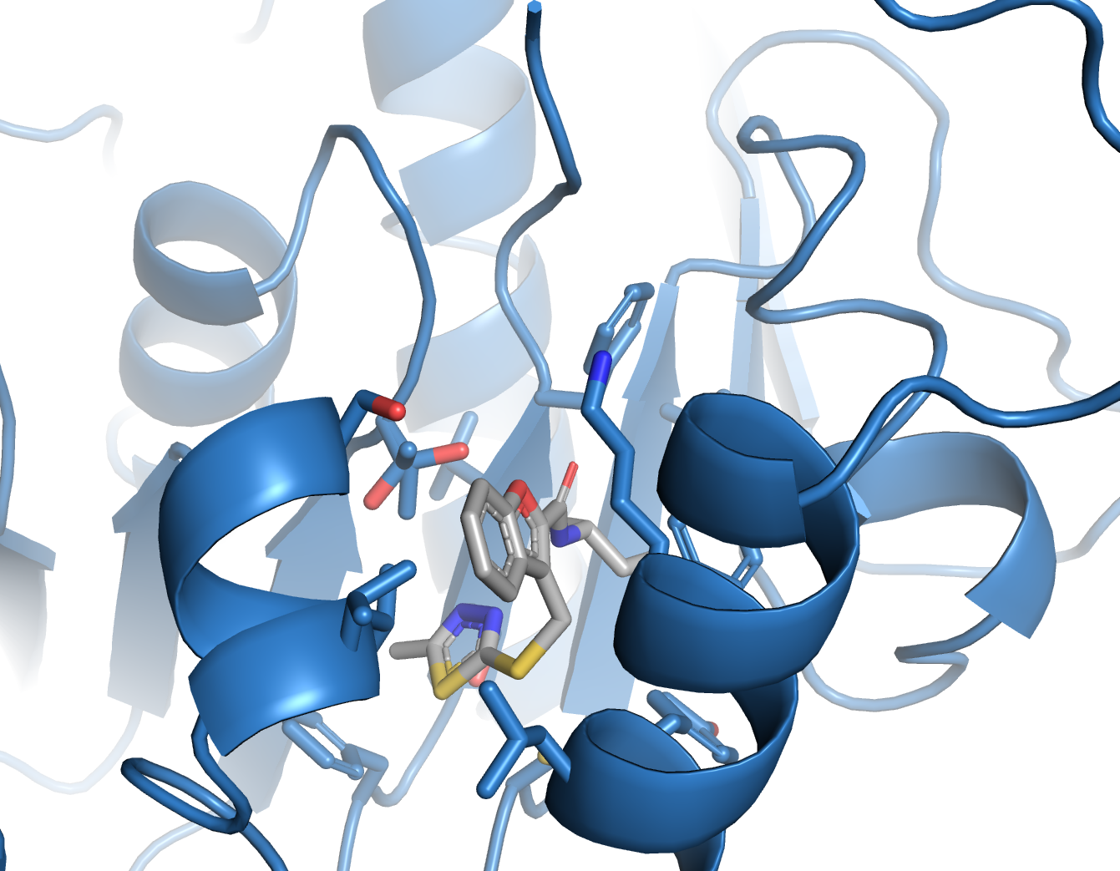
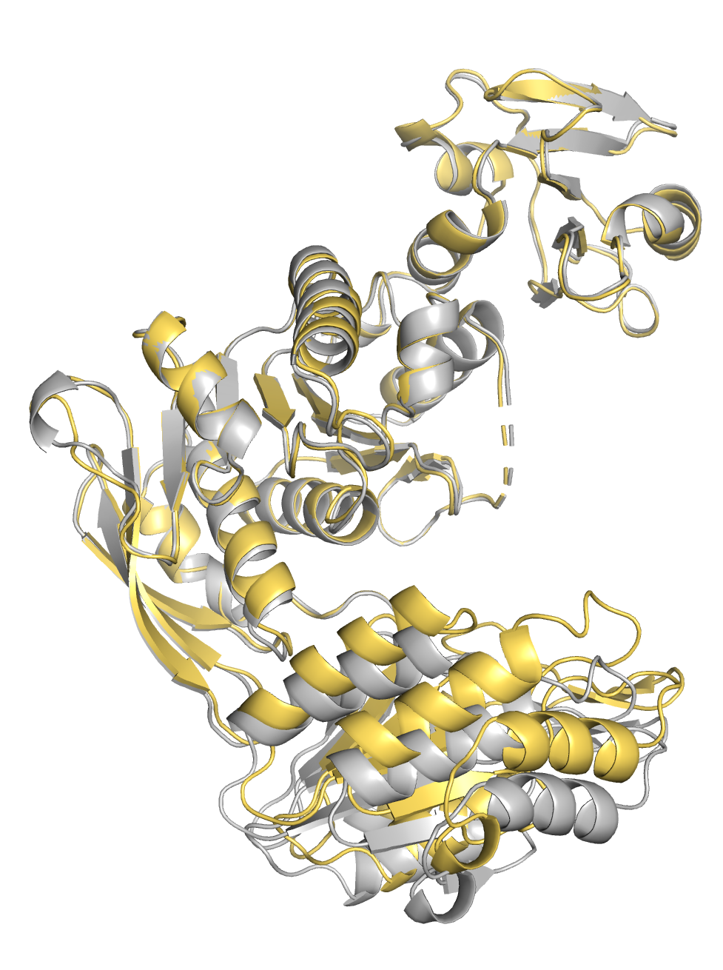
EcMurE XChem
XChem crystallization condition and results:
Libraries tested | Hits | Location
XChem fragment screening | 9 | Various, including New pocket
Enamine (from Becca and Joe) | 0 | NA
Minifrags/ Fraglites | 1 | New pocket
Tobias/Lizbé New pocket FU | 7 | New pocket
Atomwise | 8 | New pocket
China extracts | 0 | NA
Dual inhibitors * | 0 | NA
New pocket - EcMurE:Z915722616
20% PEG 4000
20% isopropanol
0.1 M citrate pH 5.5
15 mg/mL protein
1:1 protein-reservoir ratio
DMSO tolerance: 10%
The crystallization condition makes crystal mounting difficult, and reproducibility of the crystals can be is easily lost by very small variations in the crystallisation conditions.
* The crystals showed a more closed conformation:
EcMurE:dual_inhibitors
EcMurE:XChem
Summary work to find new apo conditions for EcMurE:
What was tested?:
11 different commercial crystallization screens.
3 different protein concentrations.
2 different temperatures.
3 different protein storage buffers were tested.
With and without the His₆-tag.
Results:
New crystals were obtained but the resolution was not greater than 3A.

Slide 3
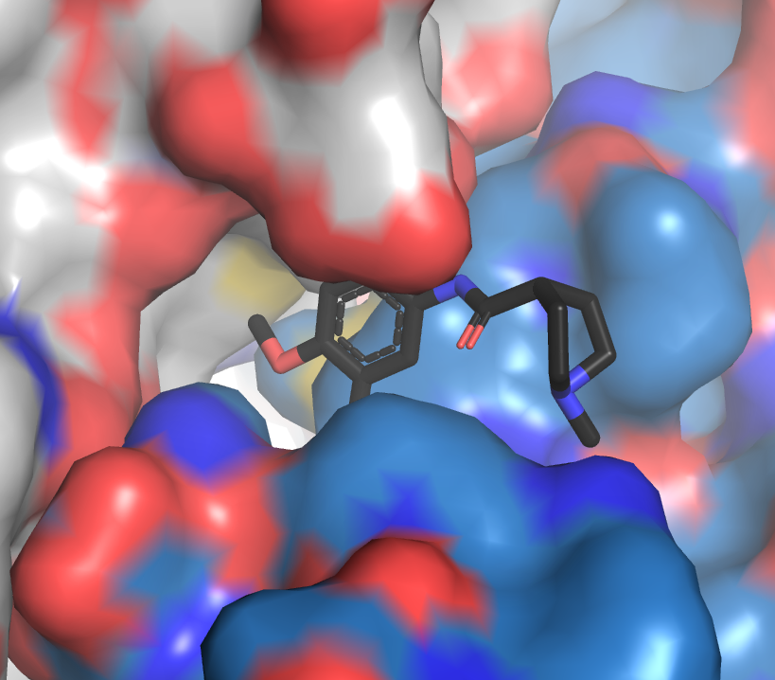
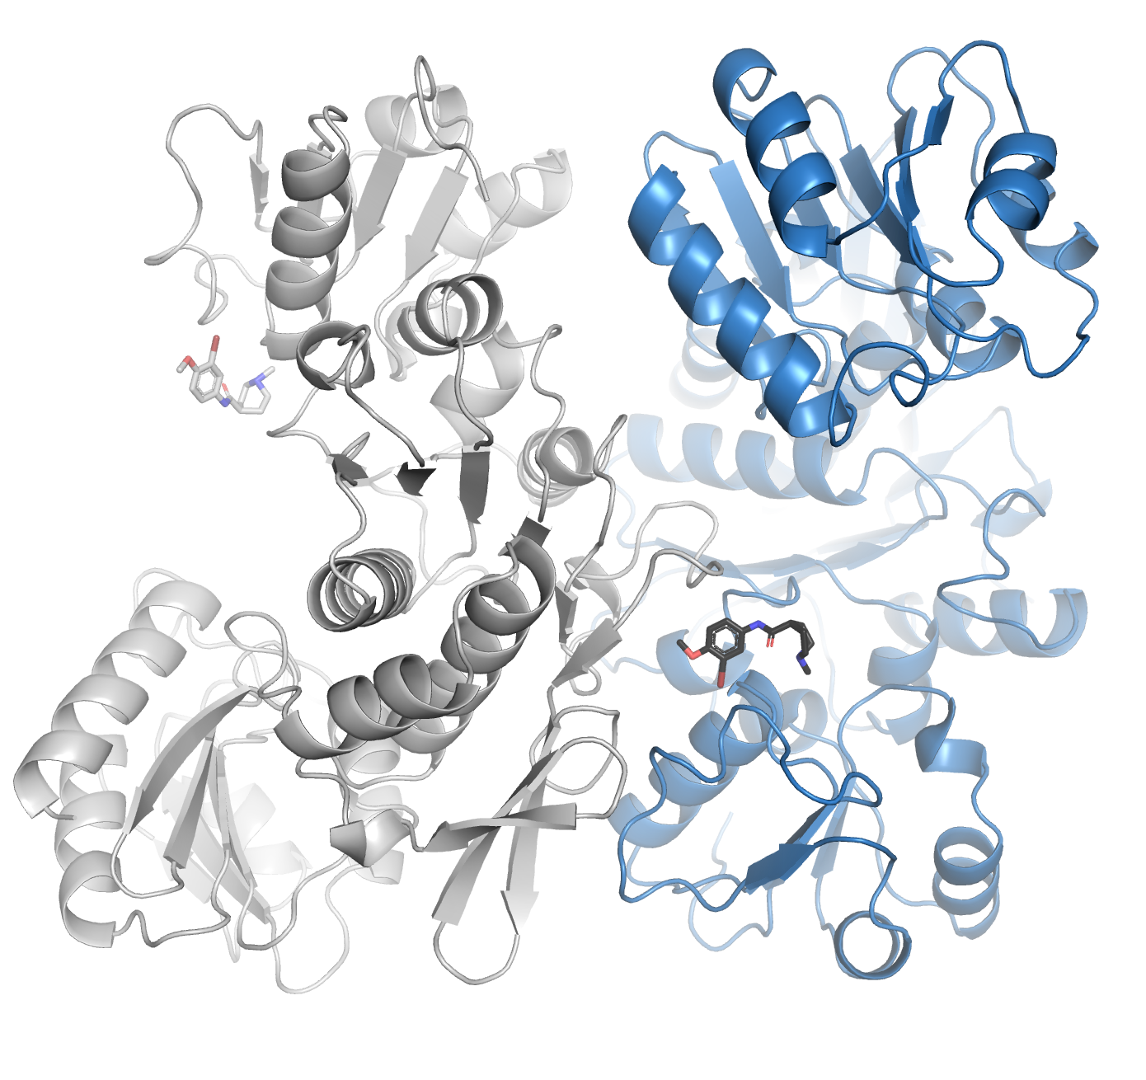
EcMurD XChem
XChem crystallization condition and results
EcMurD:#749
EcMurD symmetry related molecule
Compounds tested | Hits | Location
Dual inhibitors | 1 | Crystal contact
3% MPD
1.7M Ammonium sulphate
0.1 M MES pH 6.0
10 mg/mL protein (His₆-tagged)
1:1 protein-reservoir ratio
DMSO tolerance: 10%
EcMurD:#759
EcMurD symmetry related molecule
The presence of a compound soaking hit in a pocket created by a crystallisation contact can make the XChem efforts difficult.
Summary work finding new apo conditions for EcMurD:
What was tested?: (with Lizbe and Kato’s help)
11 different commercial crystallization screens.
3 different protein concentrations.
2 different protein storage buffers were tested.
With and without the His₆-tag.
Results:
New crystals were obtained, however the space groups and packing were always the same showing the nice crystal contact pocket.

Slide 4
What we learnt from the XChem apo proteins efforts?
Low hit rate.
Protein flexibility within the crystal allowed finding a new pocket in EcMurE, but more enzymatic information is needed to validate if inhibition could be achieved targeting the new pocket.
EcMurE flexibility was also observed when the soaking with the dual inhibitors was carried out, showing a more closed conformation.
EcMurD crystallises with the same crystallisation packing.
To target the ATP pocket we might need a closed conformation.
Summary of the effort to make closed conformation structures for XChem
EcMurE |  |  | EcMurD
Ligand | Screens | Results | Ligand | Screens | Results
ATP | 6 commercial screens, 2 protein/ligand concentrations | Apo crystals obtained | ATP | 9 commercial screens, 2 protein/ligand concentrations | No crystals yet
ADP | 6 commercial screens, 2 protein/ligand concentrations | Apo crystals obtained | ADP | 9 commercial screens, 3 protein/ligand concentrations | Structure obtained
AMPPCP | 6 commercial screens, 2 protein/ligand concentrations | No crystals yet | AMPPCP | 9 commercial screens, 3 protein/ligand concentrations | Structure obtained
UMT | 6 commercial screens, 1 protein/ligand concentrations | No crystals yet | UMA | 9 commercial screens, 3 protein/ligand concentrations | Structure obtained
Phosphate | 6 commercial screens, 3 protein/ligand concentrations | No crystals | Dual inhibitors | 6 commercial screens, 3 protein/ligand concentrations | No crystals
Dual inhibitors | 6 commercial screens, 3 protein/ligand concentrations | Crystals, poor resolution

Slide 5
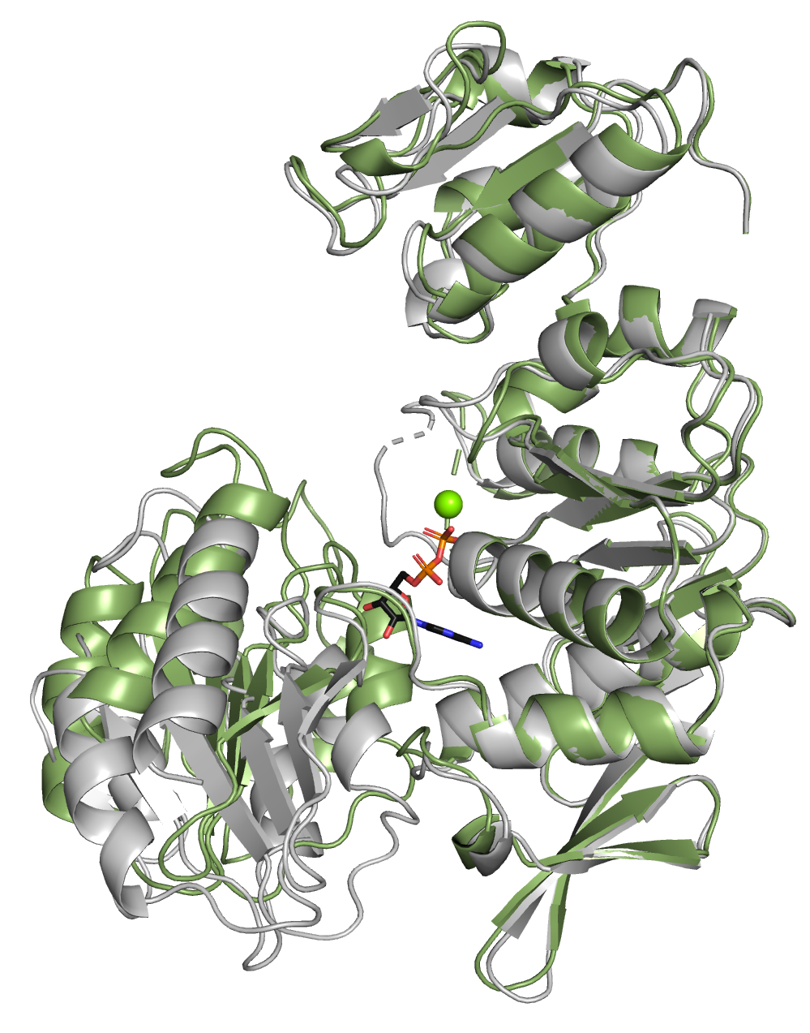
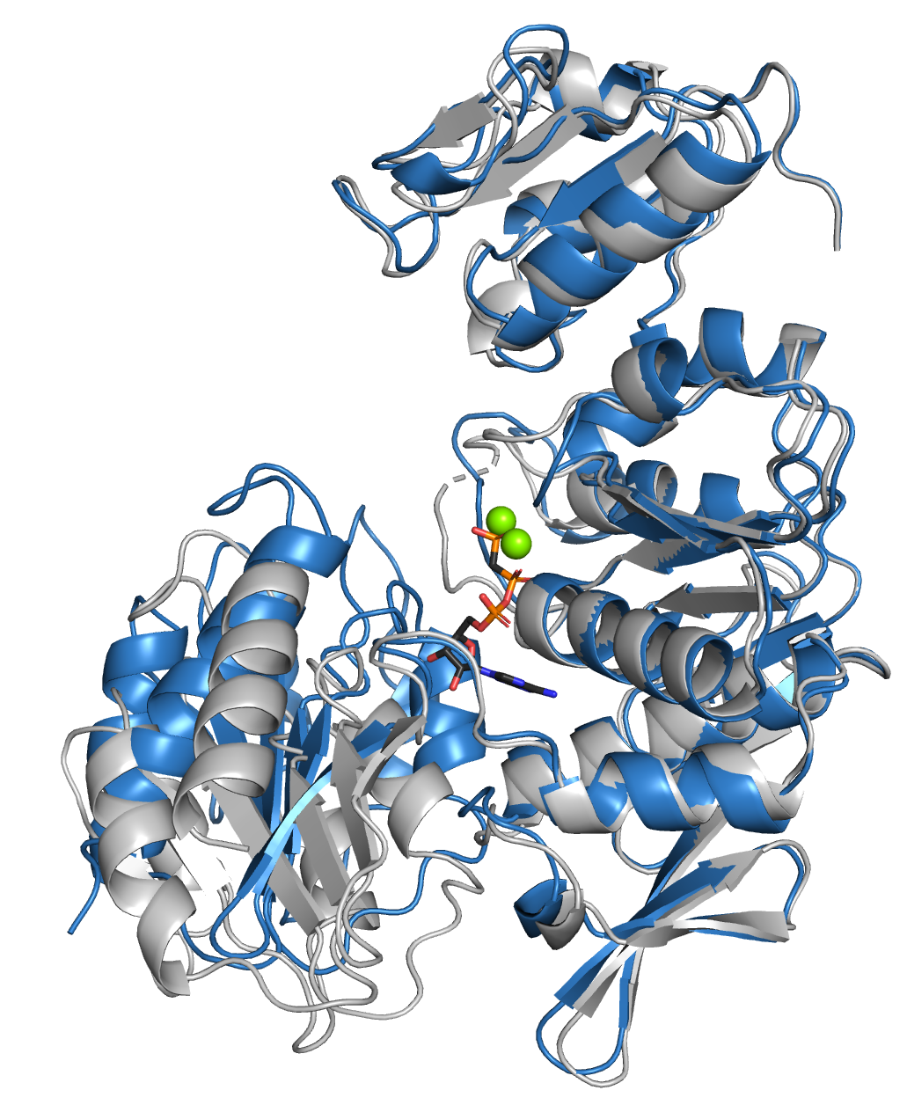
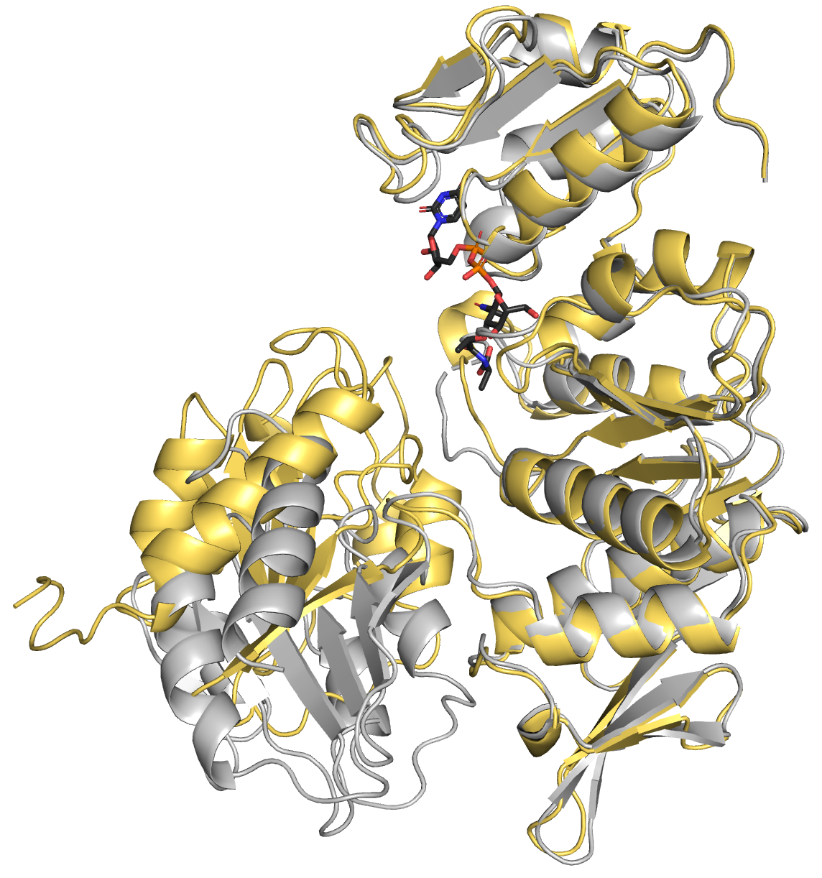
Closed EcMurD structures recently obtained
EcMurD:ADP
EcMurD:AMPPCP
EcMurD:UMA
1.7 Å
2.0 Å
2.8 Å (ligand density is very good)
EcMurD:ADP
EcMurD apo
EcMurD:AMPPCP
EcMurD apo
EcMurD:UMA
EcMurD apo
There aren’t EcMurD with ADP or AMPPCP only structures in the PDB. These should be fully refined and uploaded to the PDB.

Slide 6
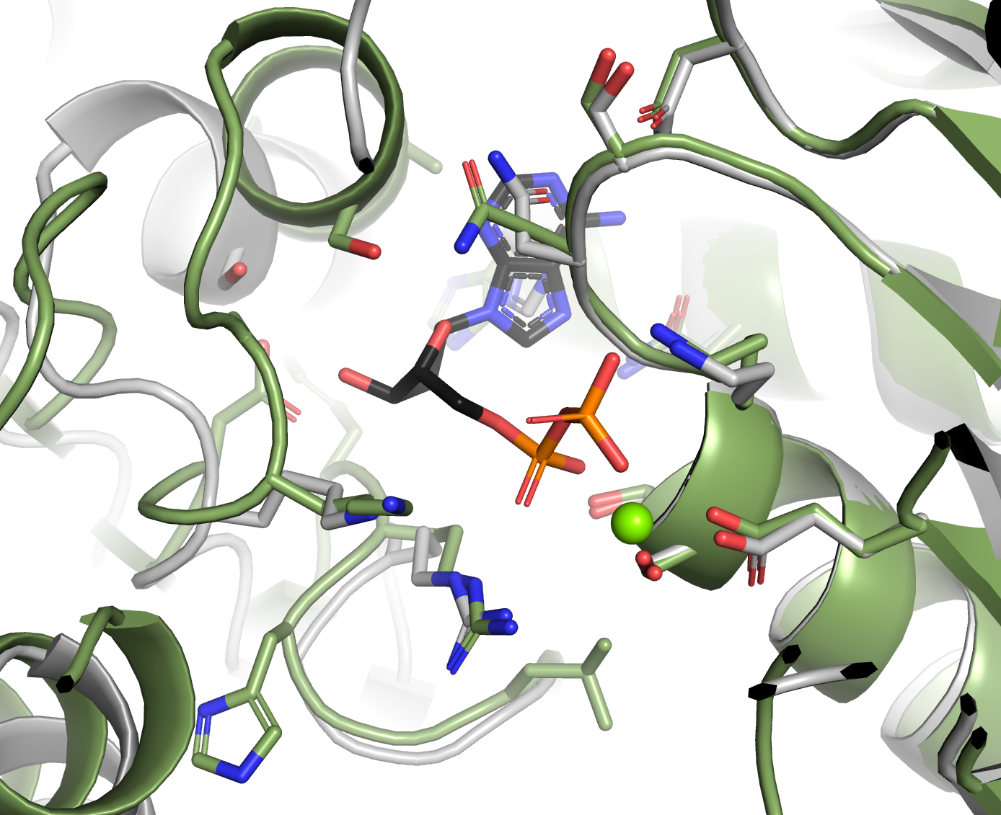
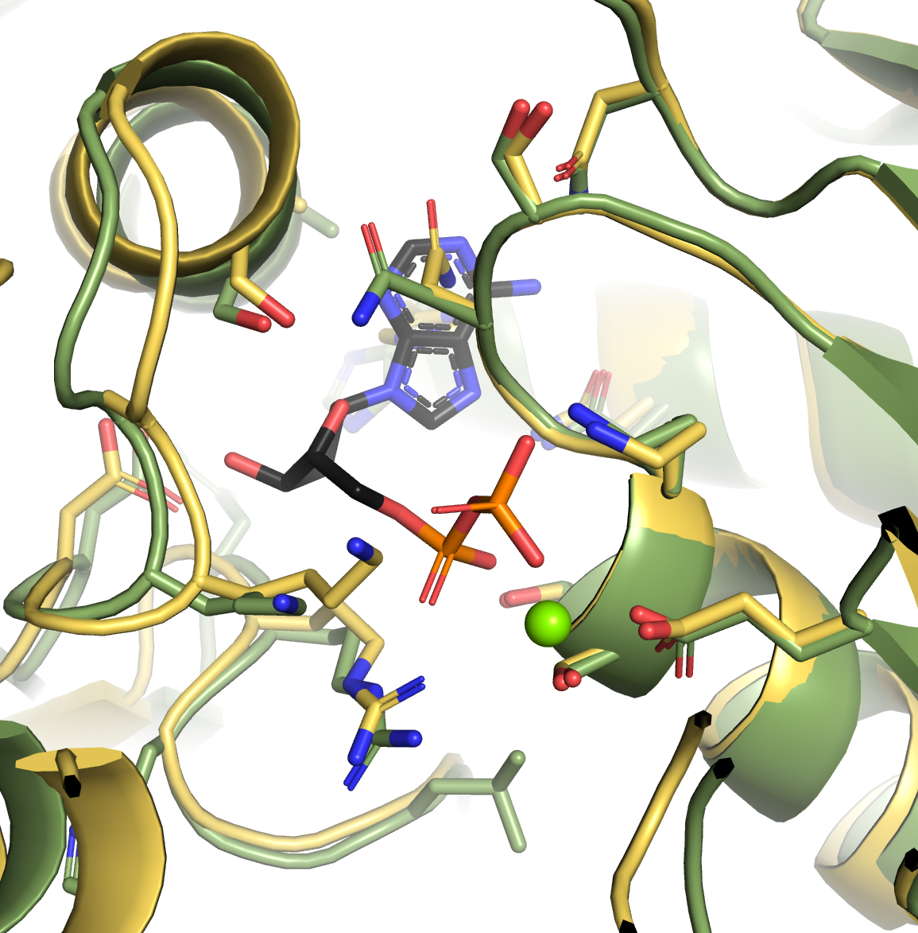
EcMurD structure comparisons – ATP site
EcMurD:ADP
EcMurD apo
EcMurD:ADP
EcMurD:UMA
Conclusions:
These new structures could deliver better ATP pocket conformations for XChem and other soaking experiments.
I would follow up EcMurD:ADP instead of EcMurD:AMPPCP. It will be easier to soak out the ADP.
On going work: Follow-up work on EcMurD:ADP and EcMurD:UMA to optimise crystals for XChem.

Slide 7
Proposed action plan
Follow-up new EcMurD closed conformation structures for XChem.
Ideally, run XChem with both ADP and UMA crystals.
Co-crystallization with the new hits obtained from the assays.
Soaking with the new hits obtained from assays:
Apo crystals (already grown): EcMurE and EcMurD
EcMurD:ADP, when new crystals are obtained (include previous hits too)
EcMurD:UMA, when new crystals are obtained (include previous hits too)
Prepare more screens to search for EcMurE close conformation structures.
Start EcMurC and/or PaMurC crystallisation work including apo and close conformations.
Any work to follow up from SSGCID?
Proposed follow up meeting for evaluating the crystallisation efforts: In 4 months.

